Slide 1

Statistical Data Analysis for data science

Slide 2
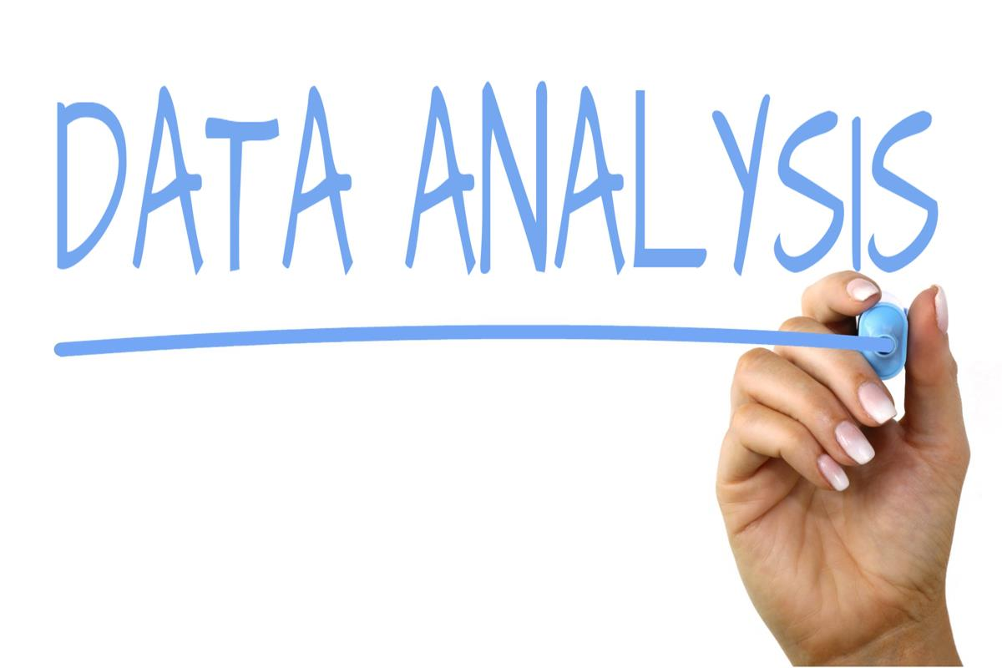
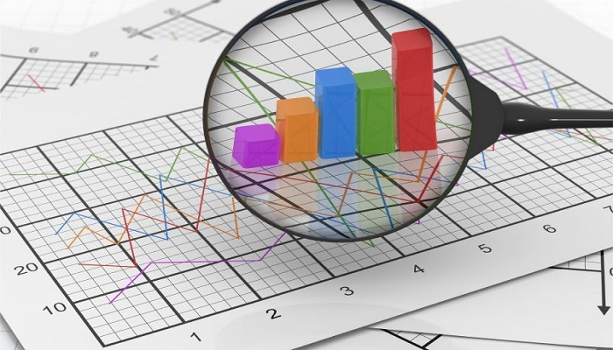
Statistical Data Analysis:
Descriptive Statistics:
Inferential Statistics:
Predictive Modeling:
Exploratory Data Analysis (EDA):
Time Series Analysis:
Cluster Analysis:
Dimensionality Reduction:
Bayesian Statistics:
Survival Analysis:
Text Mining and Natural Language Processing (NLP):
But in this week we study only Descriptive Statistics

Slide 3
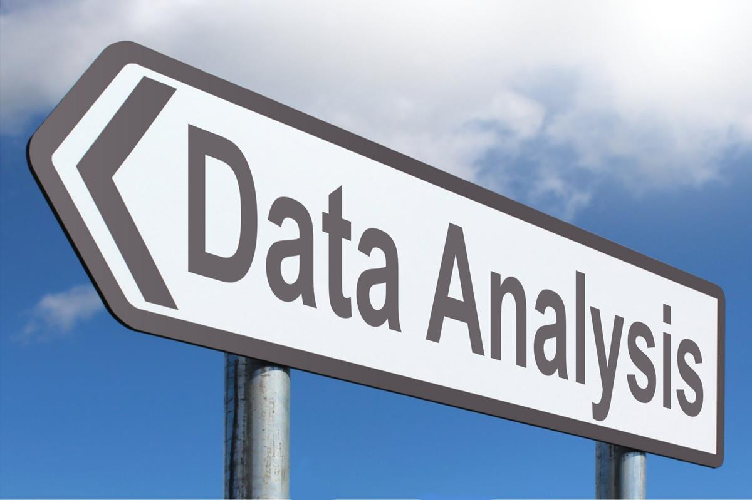
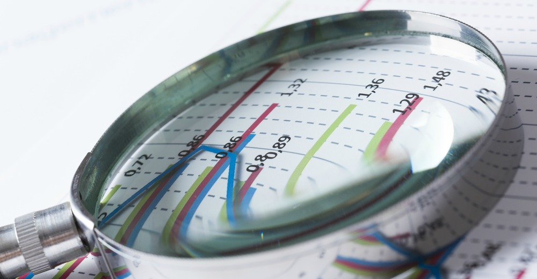
Descriptive Statistics:
Descriptive statistics in data science involve the use of numerical and graphical methods to summarize and present key features of a dataset. These statistics help in understanding the main characteristics, patterns, and distribution of the data.
TOPICS:
Measures of Central Tendency:
Measures of Dispersion or Variability:
Frequency Distribution:
Percentiles and Quartiles:
Correlation and Covariance:
Data Visualization Techniques:
Skewness and Kurtosis:
Data Cleaning and Handling Missing Values:
Interpreting and Presenting Results:

Slide 4
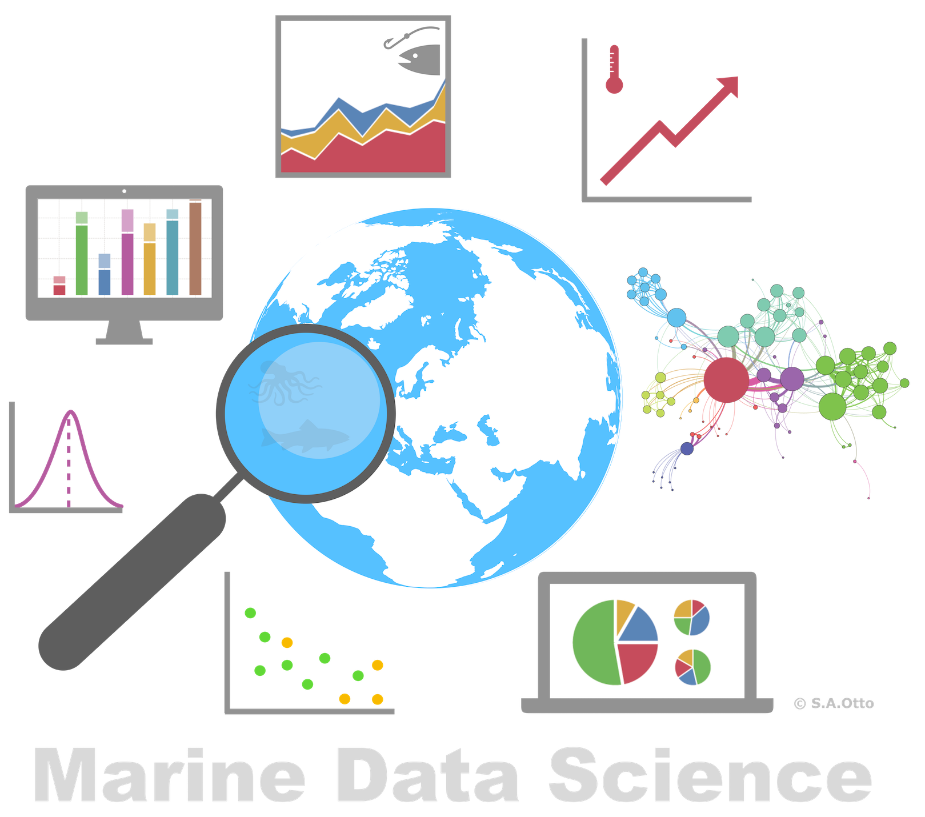





1.Measures of Central Tendency:
TOPICS:
Mean is sensitive to extreme values (outliers). If your dataset has extreme values, they can heavily influence the mean. For instance, in a dataset of salaries, a few extremely high salaries can significantly increase the mean.
Example:
in this example we can find average income of the people in city
1
2
Name | Income
Ali | 5000
Wahid | 3000
Atif | 2300
Kashif | 3245
Khan | 3456
Amir | 2223
Average | 3204
3
4
5
6

Slide 5
1.Measures of Central Tendency:
2 Median is less affected by outliers since it focuses on the middle value. It's useful when dealing with skewed distributions or when outliers might distort the average.
Example :
In this example we can not use mean because of outliers that why we can use median instead of mean.
1
2
Name | Income
Ali | 5000
Wahid | 3000
Atif | 2300
Kashif | 3245
Khan | 3456
Amir | 100000000
Mean | 16669500.17
Name | Income
Ali | 5000
Wahid | 3000
Atif | 2300
Kashif | 3245
Khan | 3456
Amir | 100000000
Median | 3350.5
3
4
5
6

Slide 6
Example:
Name | Income
Ali | 5000
Wahid | 3000
Atif | ??
Kashif | 3245
Khan | 3456
Amir | 100000000
Mean | 16669500.17
In this example we can not use mean for
Finding the missing value.
That’s why we use median for finding the mean value

Slide 7
1.Measures of Central Tendency:
Mode means most frequently occurring value in a dataset.
it’s helps to understand the most common or popular value in a set of observations.
Example :
1
2
Name | vote
Ali | pti
Wahid | anp
Atif | pti
Kashif | pmln
Khan | jui
Amir | pti
3
4
5
6

Slide 8
2.Measures of Dispersion or Variability:
Understanding variability
Identifying outliers
Comparing Datasets
TOPICS:
Range
Variance
Standard Deviation
Quartiles and IQR
Mean Absolute Deviation
Coefficient of Variation

Slide 9
2.Measures of Dispersion or Variability:
Range It's the simplest measure of dispersion and indicates the difference between the maximum and minimum values in a dataset. For example, in a set of test scores {65, 70, 75, 80, 85}, the range would be 85 - 65 = 20.
Variance It’s measures how much the values in a dataset deviate from the mean (average). It's calculated by averaging the squared differences of each value from the mean. Higher variance indicates greater dispersion. For instance, in a set of data {4, 6, 8, 10}, the variance would be calculated as [(4-7)^2 + (6-7)^2 + (8-7)^2 + (10-7)^2] / 4 = 5.
NOTE:
Range: It's the simplest measure, indicating the difference between the maximum and minimum values. However, it doesn't consider the entire dataset, making it sensitive to outliers.
Variance: It measures the average of squared deviations from the mean. It gives a comprehensive view of how each data point varies from the mean but is affected by outliers due to squaring differences.

Slide 10
2.Measures of Dispersion or Variability:
Standard Deviation It's the square root of the variance and provides a measure of the amount of variation or dispersion of a dataset's values. Using the previous example, the standard deviation would be the square root of the variance, which is √5 ≈ 2.24.
Quartiles and Interquartile Range (IQR): Quartiles divide a dataset into four equal parts, and the IQR is the range between the first (Q1) and third (Q3) quartiles. It's useful in identifying outliers and understanding the central spread of the middle 50% of the data.
NOTE:
Standard Deviation: This is the square root of the variance. It gives a measure of the average distance of data points from the mean and is commonly used due to being in the same units as the original data.
Quartiles and IQR: They divide the dataset into four equal parts, allowing you to see how the middle 50% of the data is spread. IQR is less sensitive to outliers compared to range and standard deviation.

Slide 11
2.Measures of Dispersion or Variability:
Mean Absolute Deviation: MAD calculates the average of the absolute differences between each data point and the mean. It represents the average deviation of the values from the mean. For instance, for the set {5, 8, 10, 12}, the mean absolute deviation from the mean of 8.75 would be (|5-8.75| + |8-8.75| + |10-8.75| + |12-8.75|) / 4 = 2.75.
Coefficient of Variation (CV): It's the ratio of the standard deviation to the mean and is used to compare the variability of datasets with different scales or units. A higher CV indicates higher relative variability.
NOTE:
Mean Absolute Deviation: It's more robust to outliers compared to variance or standard deviation since it uses absolute differences instead of squared differences.
Coefficient of Variation: It's the ratio of standard deviation to the mean, offering a relative measure of dispersion that allows comparison between datasets with different scales.

Slide 12
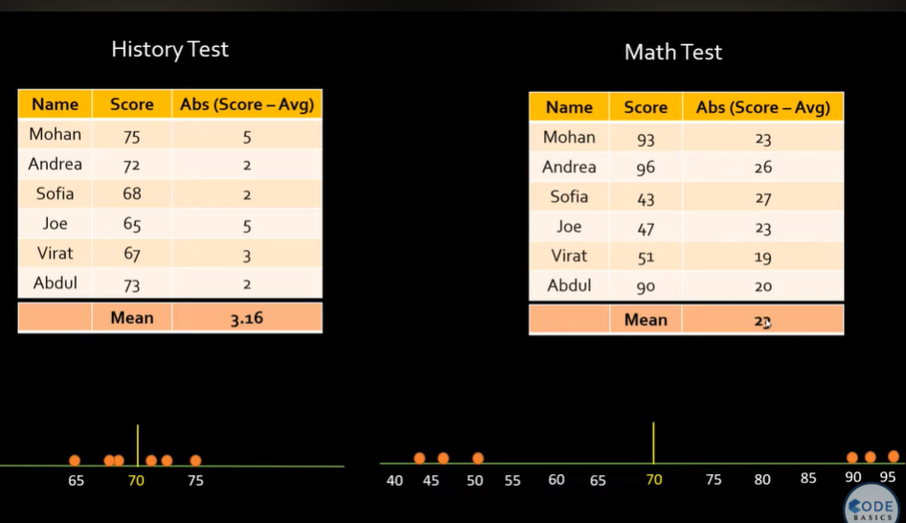
2.Measures of Dispersion or Variability:
Mean Absolute Deviation:

Slide 13
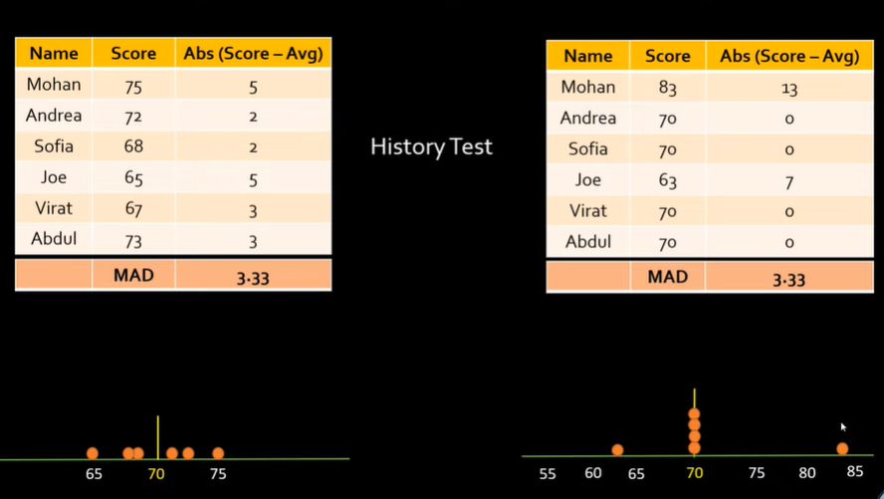
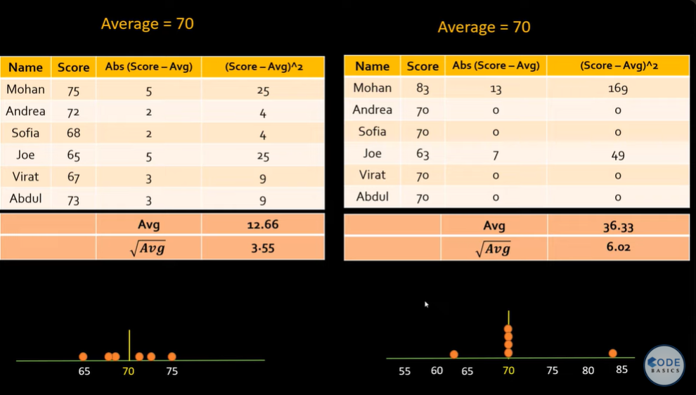
2.Measures of Dispersion or Variability:
Standard Deviation:
In this example we can’t use MAD we use SD.

Slide 14
3.Frequency Distribution
Frequency distribution in data science refers to the tabulation or arrangement of data to display the number of times specific outcomes or values occur within a dataset. It's a way of summarizing the distribution of values or categories and understanding the pattern of occurrences within a dataset.
Counting Occurrences
Organizing Data
Distribution
Discrete Frequency Distribution
Continuous Frequency Distribution
Representations
Frequency Tables
Histograms
Statistical Analysis

Slide 15
2. Frequency Distribution
Explain with help of example:
Suppose you work for an e-commerce company, and you're analyzing customer purchase amounts to understand spending patterns. You have a dataset containing the purchase amounts made by customers in the past month.
Frequency Distribution:
Data Collection: Gather the purchase amounts from the dataset.
Frequency Table: Create a frequency table by binning the purchase amounts into ranges (e.g., $0-$10, $11-$20, $21-$30, and so on) and counting the number of occurrences in each bin.
2. Histogram:
Visual Representation: Generate a histogram to visualize the distribution of purchase amounts. The x-axis represents the purchase amount ranges, while the y-axis shows the frequency (count) of customers falling into each range.

Slide 16
3. Measures of Central Tendency:
Mean: Calculate the average purchase amount across all customers.
Median: Determine the middle value in the dataset when arranged in order.
Mode: Identify the most frequent purchase amount.
4. Skewness and Kurtosis:
Skewness: Analyze if the distribution is symmetric or skewed. A positively skewed distribution may indicate a few high-value purchases.
Kurtosis: Check if the distribution has fat tails or is more peaked than a normal distribution. High kurtosis might suggest extreme values.
5. Business Insights:
Relative Frequency: Calculate the percentage of customers in different purchase amount ranges relative to the total number of customers.
Cumulative Frequency: Determine how many customers account for a certain percentage of total sales.

Slide 17
4.Percentiles and Quartiles:
Percentiles: These are values that divide a dataset into 100 equal parts.
Quartiles: These divide a dataset into four equal parts.
In data analysis:
Identifying Outliers: Percentiles and quartiles help in identifying outliers in a dataset. Values that fall significantly below Q1 or above Q3 (outside the interquartile range, IQR = Q3 - Q1) are often considered outliers.
Measuring Spread: They provide insights into the spread or dispersion of data. A wide spread between different percentiles indicates high variability, while a narrow spread implies more consistency.
Data Comparison: Percentiles enable comparison between different parts of datasets or different datasets, allowing analysts to compare how certain values rank across multiple groups.
Data Normalization: Percentiles are used in normalizing or standardizing data, making it easier to compare values from different distributions or datasets.

Slide 18
5. Correlation and Covariance:
Covariance: Covariance measures the degree to which two random variables vary together. It assesses how changes in one variable are associated with changes in another. A positive covariance indicates that two variables tend to increase or decrease together, while a negative covariance suggests that one variable increases as the other decreases. However, it doesn't indicate the strength or direction of the relationship.
Correlation: Correlation, on the other hand, standardizes the measure of association between two variables. It provides a scaled measure, ranging from -1 to 1, that indicates both the strength and direction of the linear relationship between two variables. A correlation of 1 signifies a perfect positive linear relationship, -1 indicates a perfect negative linear relationship, and 0 suggests no linear relationship between the variables.

Slide 19
In data analysis:
Understanding Relationships: Covariance and correlation help in understanding how changes in one variable are associated with changes in another. They provide insights into whether variables move together, move in opposite directions, or show no clear relationship.
Strength of Association: Correlation specifically measures the strength of the relationship. A correlation closer to 1 or -1 indicates a stronger relationship, while a value closer to 0 suggests a weaker relationship.
Independence Assessment: Covariance and correlation aid in assessing the independence of variables. If variables are uncorrelated (correlation close to 0), it doesn't necessarily mean they are independent, but independence implies zero correlation.
Data Analysis and Predictions: They are used extensively in predictive modeling and data analysis. Understanding the relationships between variables helps in building models, predicting outcomes, and identifying key factors affecting a particular phenomenon.

Slide 20


Thank You
Amir Aziz
Amiraziz.uet@gmail.com

